Slide 1

DEE 4224 – ELECTRONIC DEVICES AND OPERATIONS 1
Chapter 2b
Small Signal Analysis of BJT Amplifier

Slide 2
OBJECTIVES
Discuss the concept of dc biasing of a transistor
Analyze base bias, emitter bias, voltage-divider bias and collector-feedback bias circuits.
Basic troubleshooting for transistor bias circuits.

Slide 3
INTRODUCTION
For the transistor to properly operate it must be biased. There are several methods to establish the DC operating point.
We will discuss some of the methods used for biasing transistors as well as troubleshooting methods used for transistor bias circuits.

Slide 4
BIASING & 3 STATES OF OPERATION
Active or Linear Region Operation
Base–Emitter junction is forward biased
Base–Collector junction is reverse biased
Cutoff Region Operation
Base–Emitter junction is reverse biased
Saturation Region Operation
Base–Emitter junction is forward biased
Base–Collector junction is forward biased

Slide 5
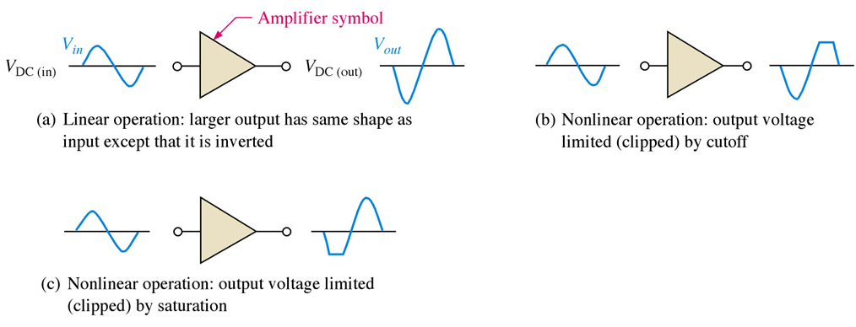
DC OPERATING POINT
The goal of amplification in most cases is to increase the amplitude of an ac signal without altering it.

Slide 6
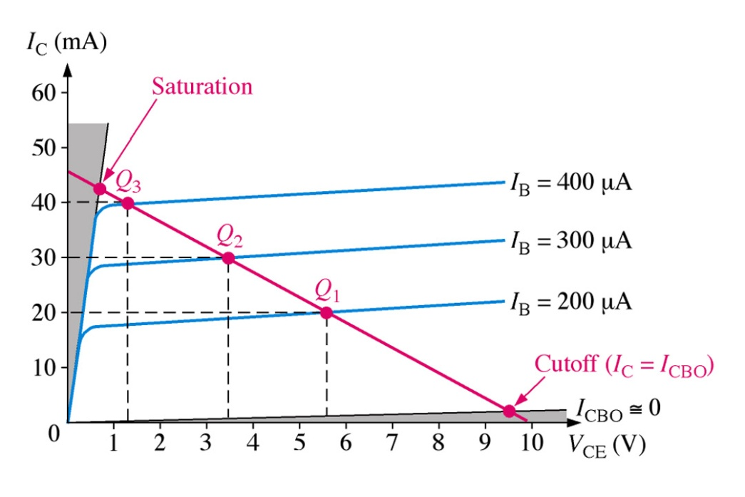
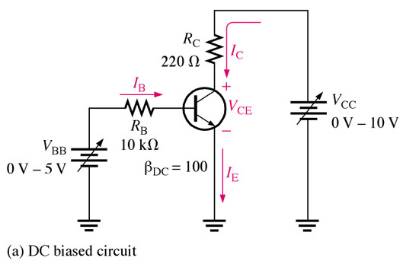
DC OPERATING POINT
For a transistor circuit to amplify it must be properly biased with dc voltages. The dc operating point between saturation and cutoff is called the Q-point. The goal is to set the Q-point such that that it does not go into saturation or cutoff when an a ac signal is applied.
I_{B} ↑ → I_{C}↑ and V_{CE} ↓
I_{B}↓→ I_{C} ↓ and V_{CE} ↑

Slide 7
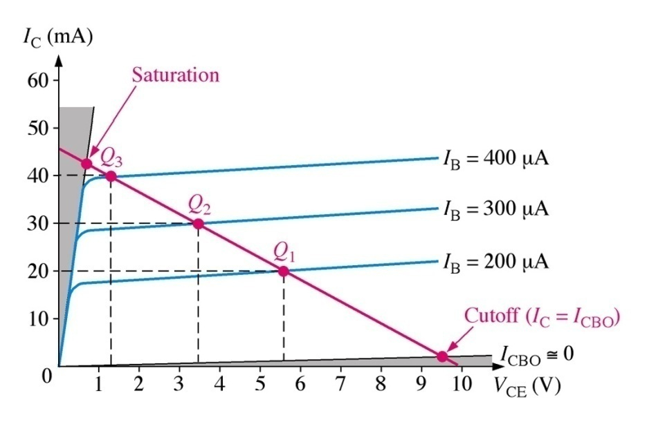
DC OPERATING POINT
Recall that the collector characteristic curves graphically show the relationship of collector current, I_{C} and V_{CE} for different base currents, I_{B}. With the dc load line superimposed across the collector curves for this particular transistor we see that 30 mA of collector current (at I_{B} = 300 μA) is best for maximum amplification, giving equal amount above and below the Q-point. Note that this is three different scenarios of collector current being viewed simultaneously.

Slide 8
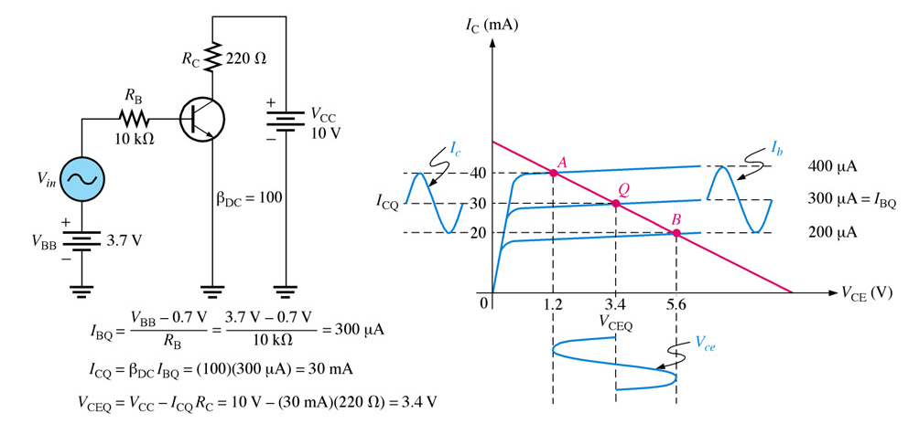
DC OPERATING POINT
With a good Q-point established, look at the effect of superimposed ac voltage has on the circuit. Note the collector current swings do not exceed the limits of operation (saturation and cutoff). However, as you might already know, applying too much ac voltage to the base would result in driving the collector current into saturation or cutoff resulting in a distorted or clipped waveform.

Slide 9
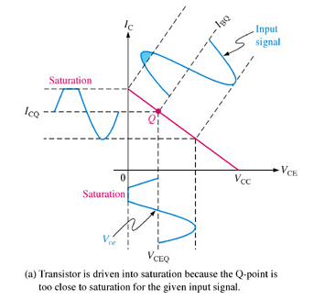
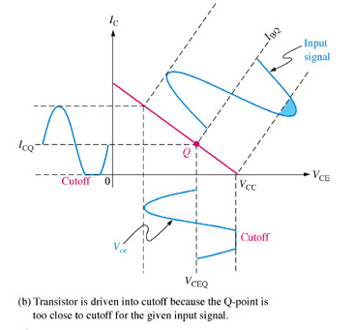
WAVEFORM DISTORTION
Graphical load line illustration of a transistor being driven into saturation and/or cutoff

Slide 10
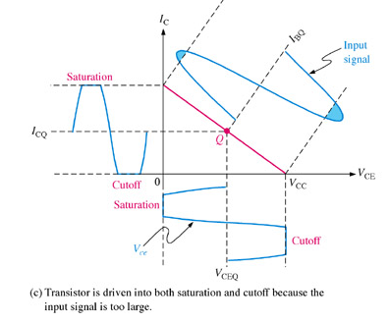
WAVEFORM DISTORTION

Slide 11
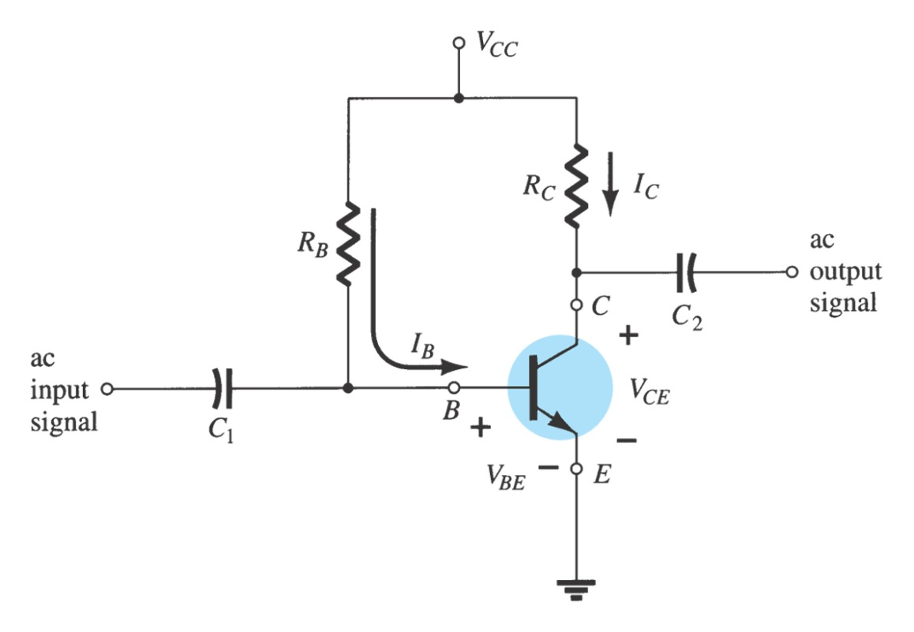
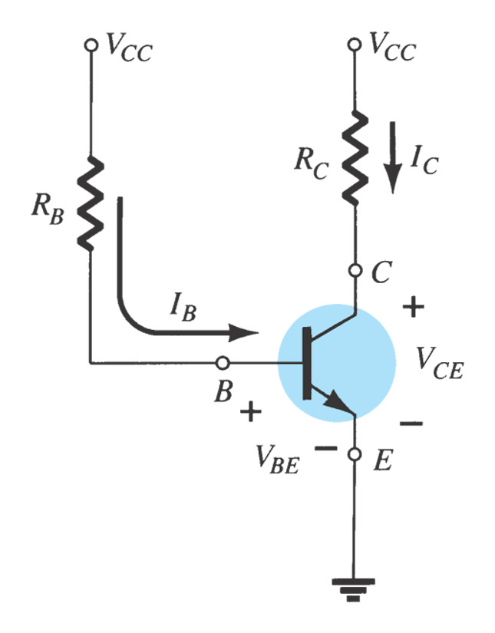
FIXED-BIAS (BASE-BIAS) CIRCUIT
Simplest transistor bias configuration.
Commonly used in relay driver circuits.
Extremely beta-dependant and very unstable
Fixed-bias circuit.
DC equivalent circuit.

Slide 12
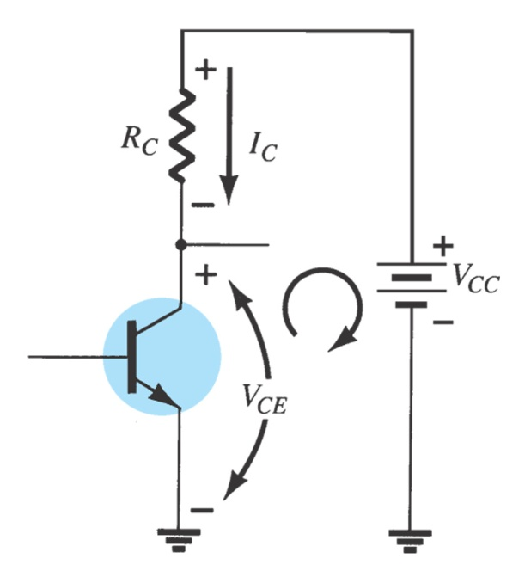
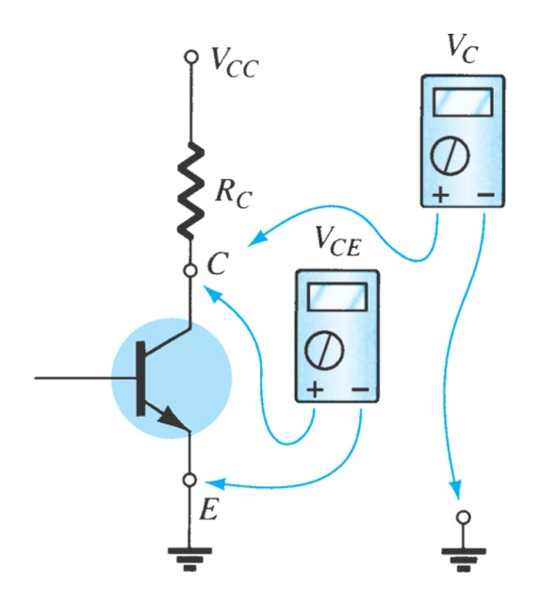
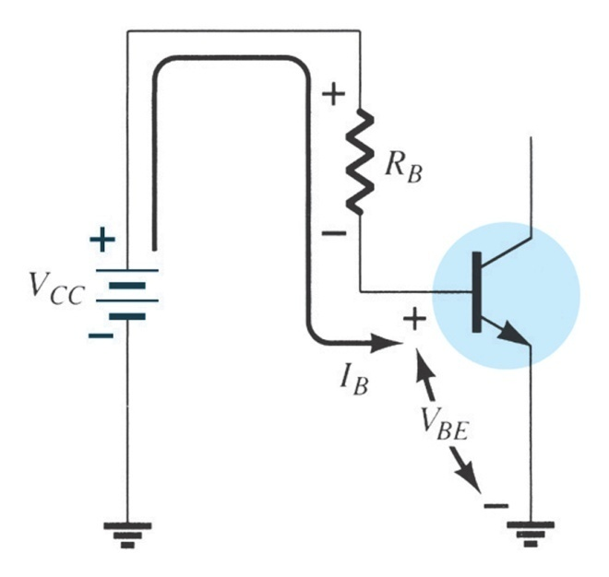
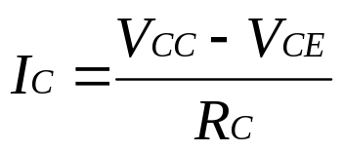
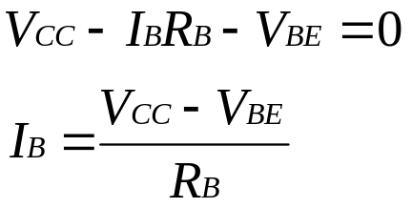
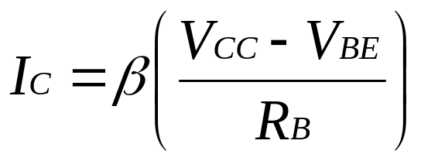
BASE-BIAS (FIXED-BIAS) CIRCUIT
Measuring V_{CE} and V_{C}.
Base – Emitter loop
Collector – Emitter loop
V_{CC} – I_{C}R_{C} – V_{CE} = 0
V_{CE} = V_{CC} – I_{C}R_{C}; then
= V_{C} – V_{E} since V_{E} = 0
V_{CE} = V_{C}
V_{BE} = V_{B} – V_{E} (since V_{E} = 0)
V_{BE} = V_{B}
Since I_{C} = βI_{B}, then
Sensitive to Beta

Slide 13
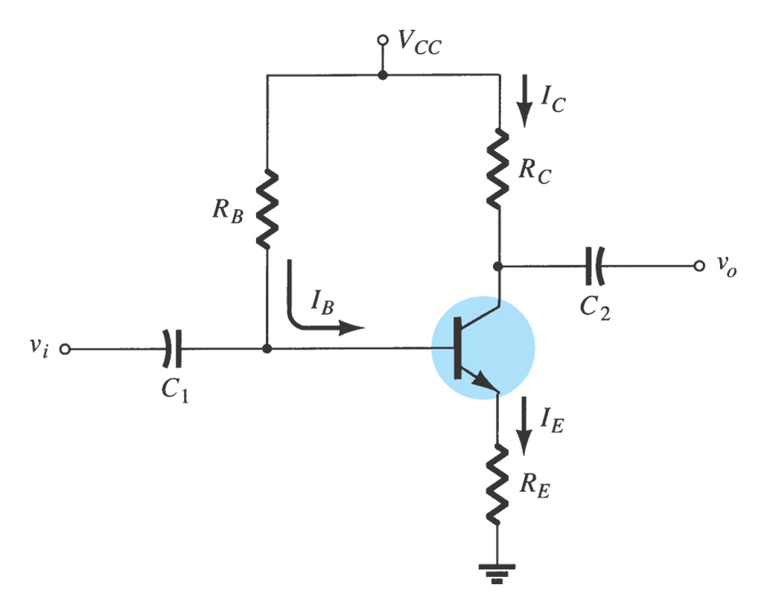
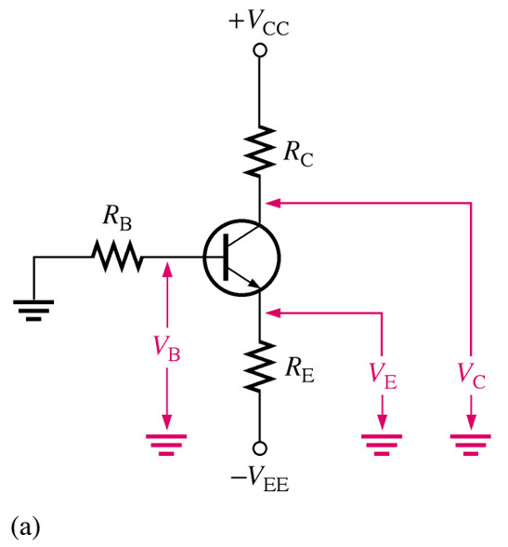
EMITER BIAS
Use both a positive and a negative supply voltage on emitter or it just contain an emitter resistor to improve stability level over fixed – bias configuration.
An npn transistor with emitter bias. Polarities are reversed for a pnp transistor. Single subscripts indicate voltages with respect to ground.
BJT bias circuit with emitter resistor.

Slide 14
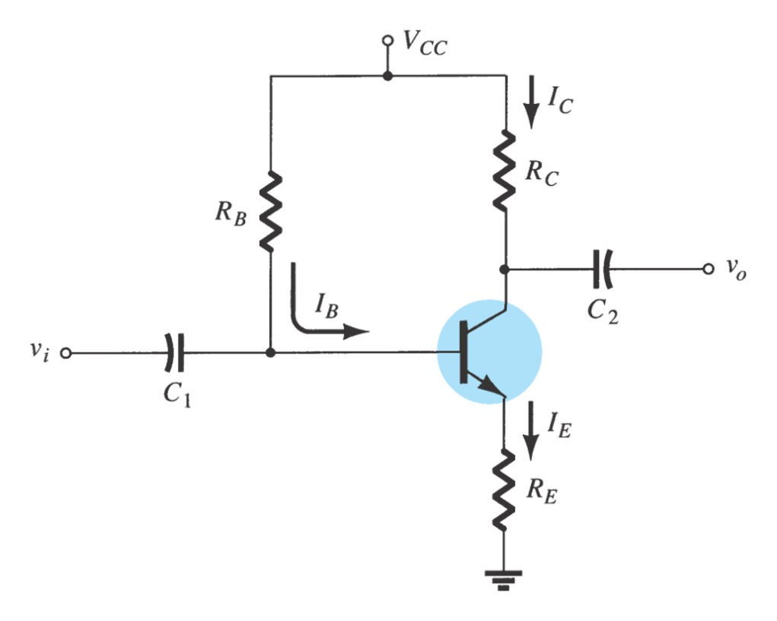
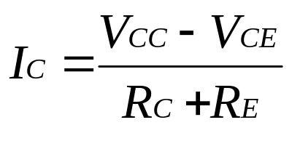
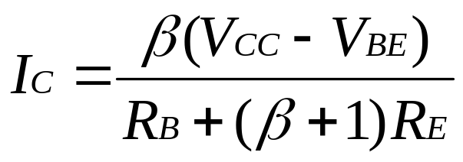
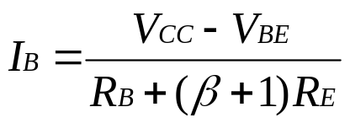
EMITER BIAS – only R_{E}
Collector – Emitter loop
V_{CC} – I_{C}R_{C} – V_{CE} – I_{E}R_{E} = 0
I_{E} ≅ I_{C}
V_{CC} – I_{C}R_{C} – V_{CE} –I_{C}R_{E} = 0
V_{CC} – V_{CE} = I_{C} (R_{C} + R_{E})
BJT bias circuit with emitter resistor.
Base – Emitter loop
V_{CC} – I_{B}R_{B} – V_{BE} – I_{E}R_{E} = 0
I_{E} = (β + 1) I_{B}
Then, V_{CC} – I_{B}R_{B} – V_{BE} – (β + 1)I_{B}R_{E} = 0.
Since I_{C} = βI_{B}, so I_{C} also equivalent to
Less sensitivity to beta

Slide 15
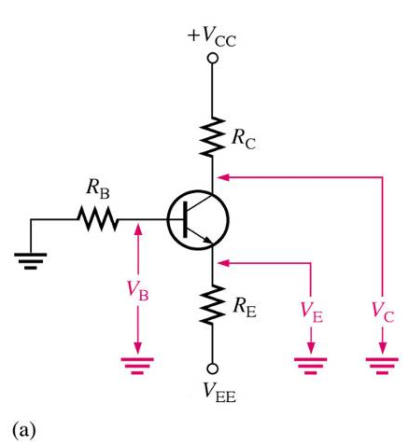
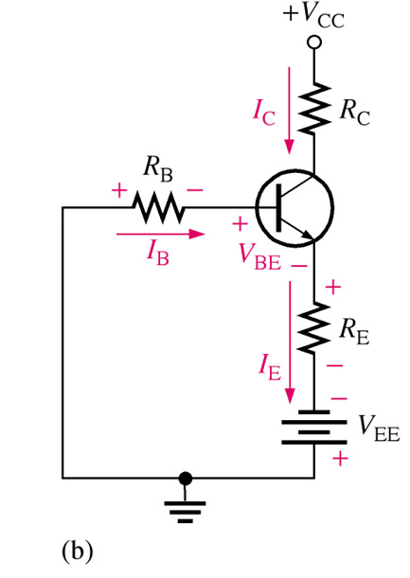
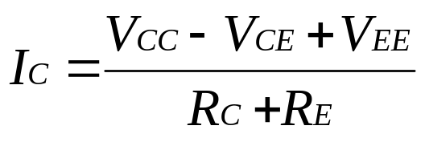
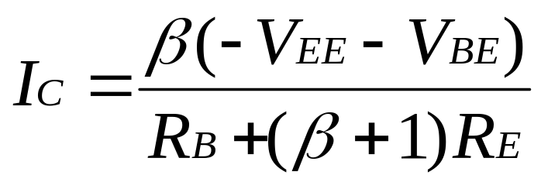
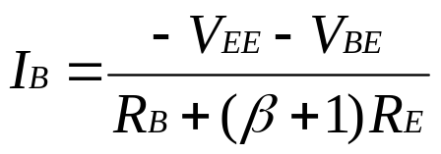
EMITER BIAS – R_{E} + DC Voltage Supply
Collector – Emitter loop
V_{CC} – I_{C}R_{C} – V_{CE} – I_{E}R_{E} + V_{EE} = 0
I_{E} ≅ I_{C}
V_{CC} – I_{C}R_{C} – V_{CE} –I_{C}R_{E} + V_{EE} = 0
V_{CC} – V_{CE} + V_{EE} = I_{C} (R_{C} + R_{E})
Base – Emitter loop
V_{EE} + I_{B}R_{B} + V_{BE} + I_{E}R_{E} = 0
I_{E} = (β + 1) I_{B}
Then, V_{EE} + I_{B}R_{B} + V_{BE} + (β + 1)I_{B}R_{E} = 0.
Less sensitivity to beta

Slide 16
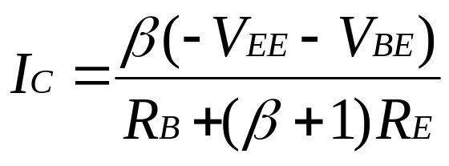
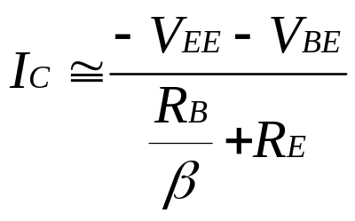
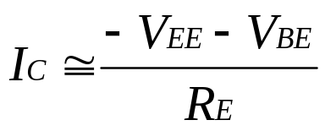
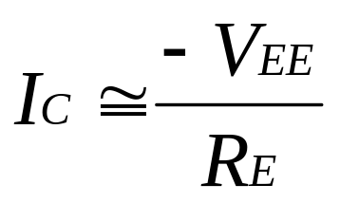
EMITTER BIAS - Summary
With DC Voltage supply + Resistor at Emitter
With only Resistor at Emitter
Previous analysis we use I_{E} = (β + 1) I_{B}; but if use I_{E} ≅ I_{C} ≅ βI_{B}, then from previous slide we can get.
If R_{E} >>> R_{B}/β then we can drop R_{B}/β in equation
Less sensitivity to beta or independent to beta
OR we also can use β≅ (β + 1)
to get the same result.
If V_{EE} >>> V_{BE} then
Independent to V_{BE}

Slide 17
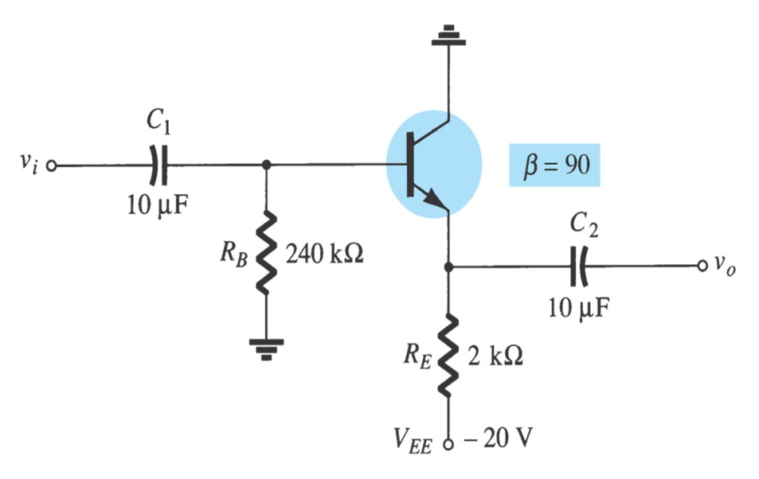
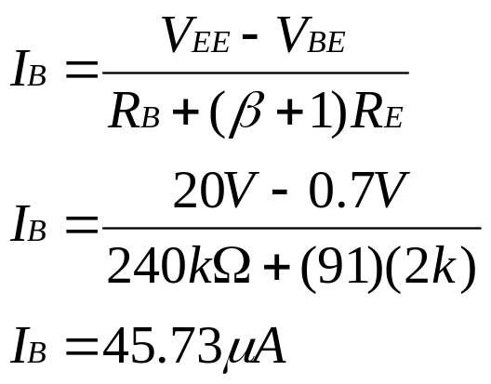
EXAMPLE
Determine VCEQ and IE for the network as shown in Fig.
-V_{EE} + I_{E}R_{E} + V_{CE} = 0
I_{E} = (β + 1)I_{B}
V_{CEQ} = V_{EE} – (β+1)R_{E}
= 20V – (91)(45.73μ)(2kΩ)
= 11.68 mA
I_{E} = 4.16 mA
V_{EE} – I_{B}R_{B} – V_{BE} – I_{E}R_{E} = 0
I_{E} = (β + 1)I_{B}

Slide 18
EMITTER BIAS - Summary
Adding RE to the emitter improves the stability of a transistor.
    Stability refers to a bias circuit in which the currents and voltages will remain fairly constant for a wide range of temperatures and transistor Beta (β) values.

Slide 19
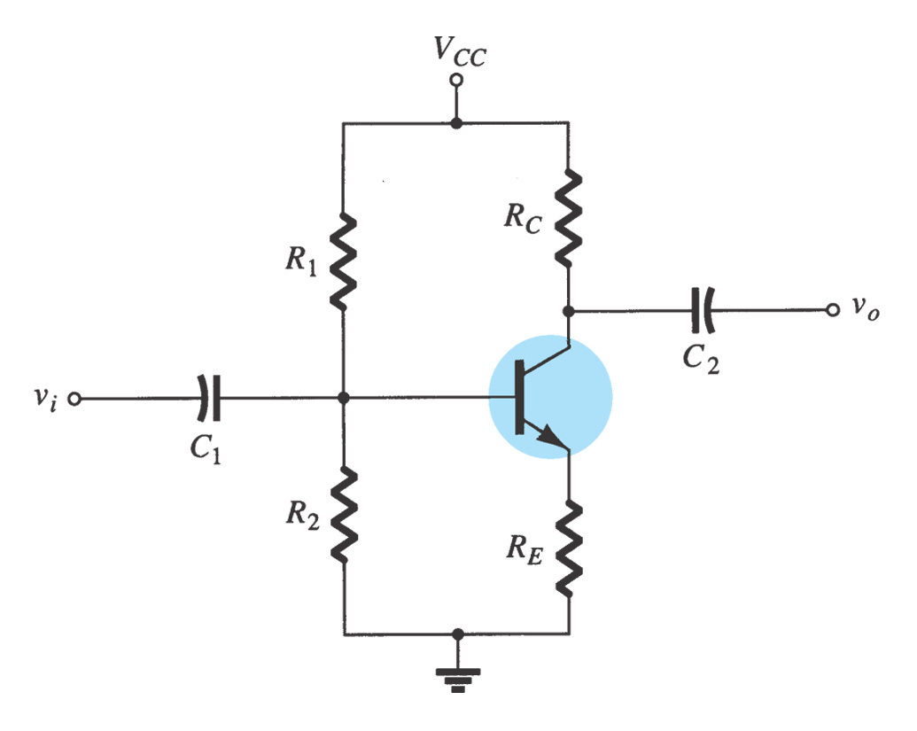
VOLTAGE DIVIDER BIAS
The most widely used type of bias circuit. Only one power supply is needed and voltage-divider bias is more stable (β independent) than other bias types.
Two methods of analysis, exact and approximate analysis

Slide 20
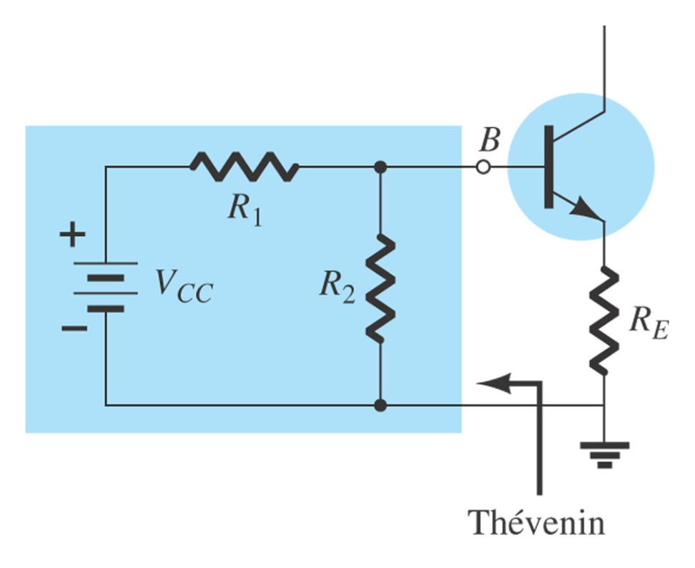
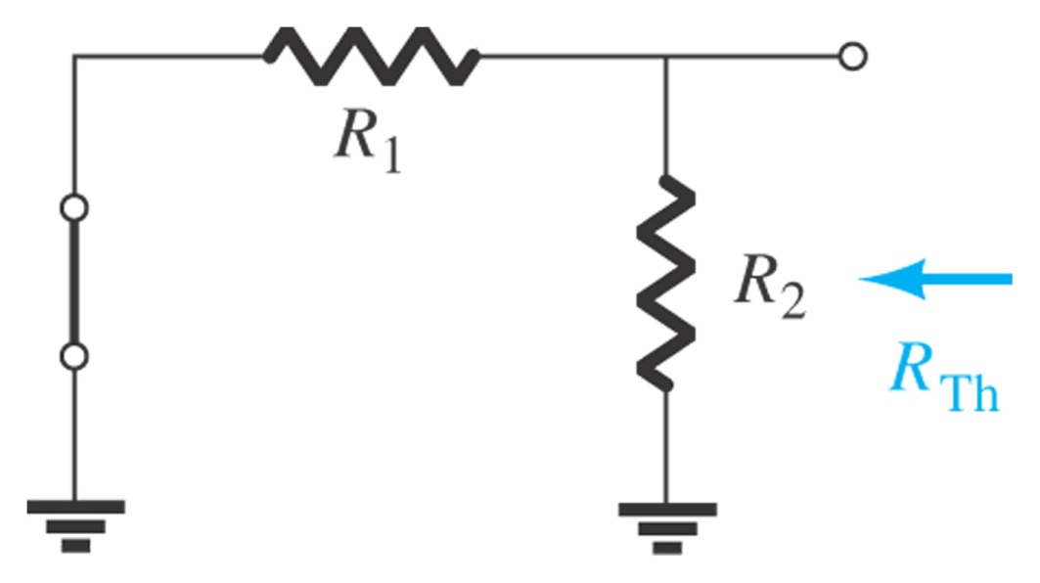
VOLTAGE DIVIDER BIAS – Exact Analysis
Determining R_{TH}.
To determine R_{TH} → The voltage source is replaced by a short-circuit equivalent, resulting……..
R_{TH} = R₁ ǁ R₂

Slide 21
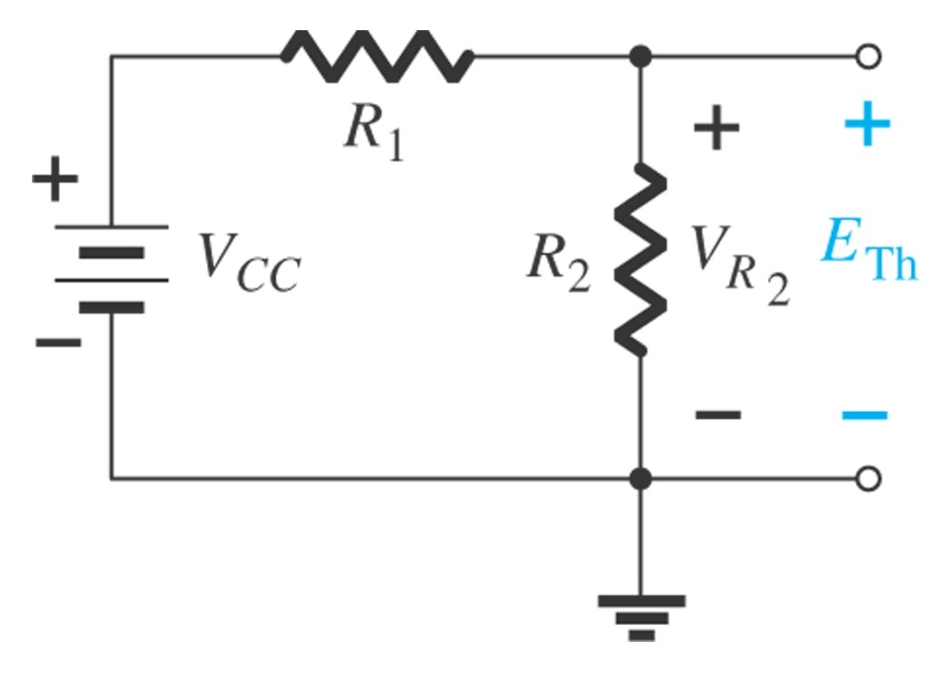
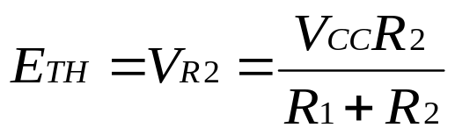
VOLTAGE DIVIDER BIAS – Exact Analysis
To determine ETH → The voltage source VCC remained on the network and the open circuit Thevenin voltage can be determined.
Determining E_{TH}.

Slide 22
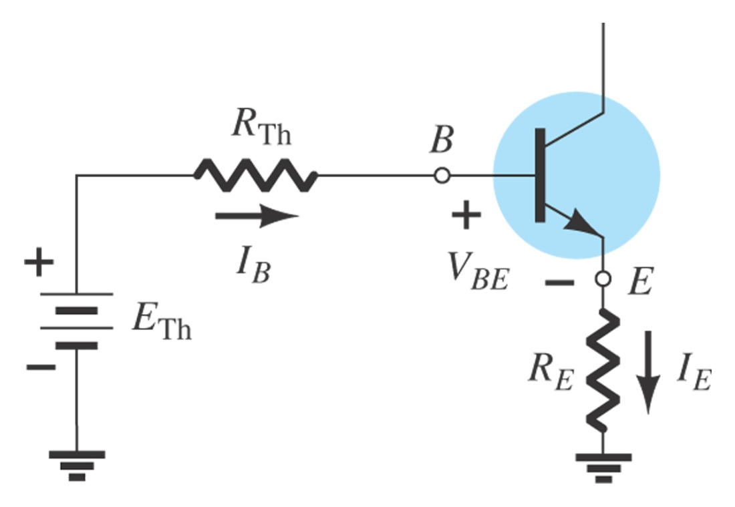
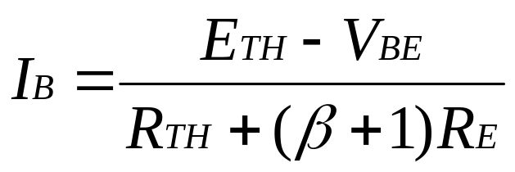
VOLTAGE DIVIDER BIAS – Exact Analysis
The Thevenin network is then redrawn and I_{BQ} can be determined by applying Kirchoff’s voltage law.
E_{TH} – I_{B}R_{TH} – V_{BE} – I_{E}R_{E} = 0,
….substitute I_{E} = (β + 1) I_{B}….. then
Almost similar with emitter bias
Voltage differences over resistance.

Slide 23
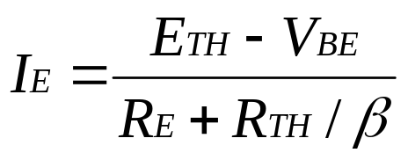
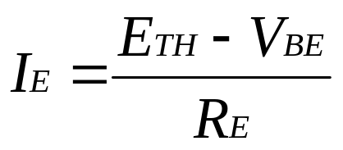
VOLTAGE DIVIDER BIAS – Exact Analysis
I_{C} = βI_{B} ; I_{E} = (β + 1) I_{B} ≅ βI_{B}
Substituting between these OR equation in previous slide (from derivation), resulting :
If R_{E} >>> R_{TH}/β, then…
Independent to Beta

Slide 24
VOLTAGE DIVIDER BIAS – Exact Analysis
Once I_{B} is known, the rest of the parameters can be determined.
V_{CE} = V_{CC} – I_{C} (R_{C} + R_{E})
The remaining equations V_{E}, V_{C} and V_{B} are also similar as obtained in emitter bias configuration.
Voltage-divider bias configuration.

Slide 25
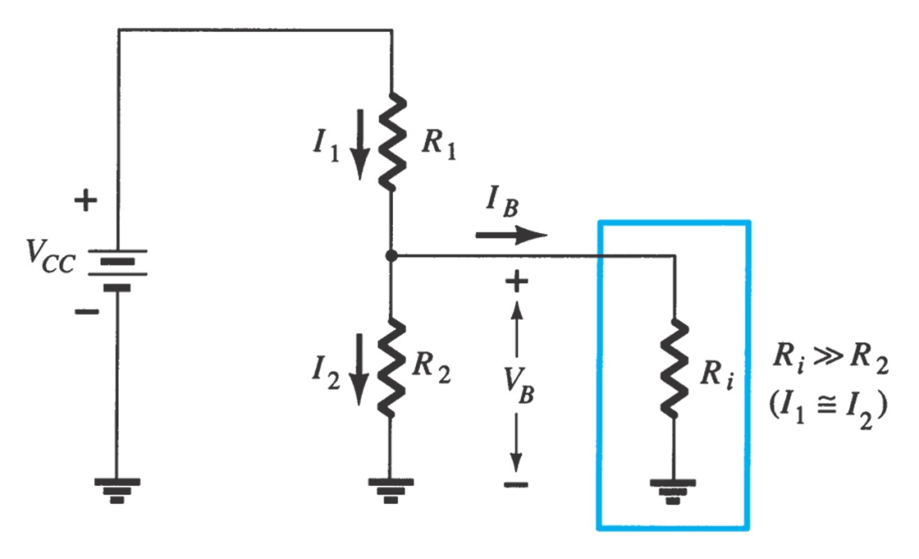
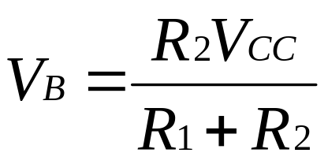
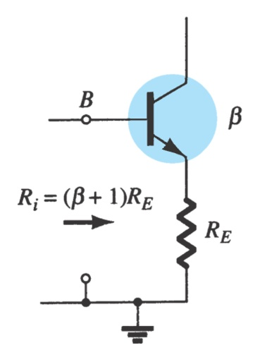
VOLTAGE DIVIDER BIAS – Approximate Analysis
and
R_{i} = (β + 1)R_{E} ≅ βR_{E}
with condition
βR_{E} ≥ 10R₂
Partial-bias circuit for calculating the approximate base voltage V_{B}.
If beta times the value R_{E} is at least 10x the value R₂, the approximate approach can be applied with high accuracy.
R_{i} = equivalent transistor between base and ground for transistor with an emitter resistor R_{E}

Slide 26

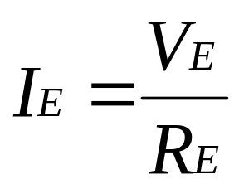
VOLTAGE DIVIDER BIAS – Approximate Analysis
Once V_{B} is determined, the level of V_{E} can be calculated.
V_{E} = V_{B} – V_{BE}
And emitter current
and I_{C} ≅ I_{E}
V_{CE} = V_{CC} –I_{C}R_{C} –I_{E}R_{E} but
since I_{E} ≅ I_{C}
V_{CE}= V_{CC} – I_{E} (R_{C} + R_{E})
Partial-bias circuit for calculating the approximate base voltage V_{B}.

Slide 27
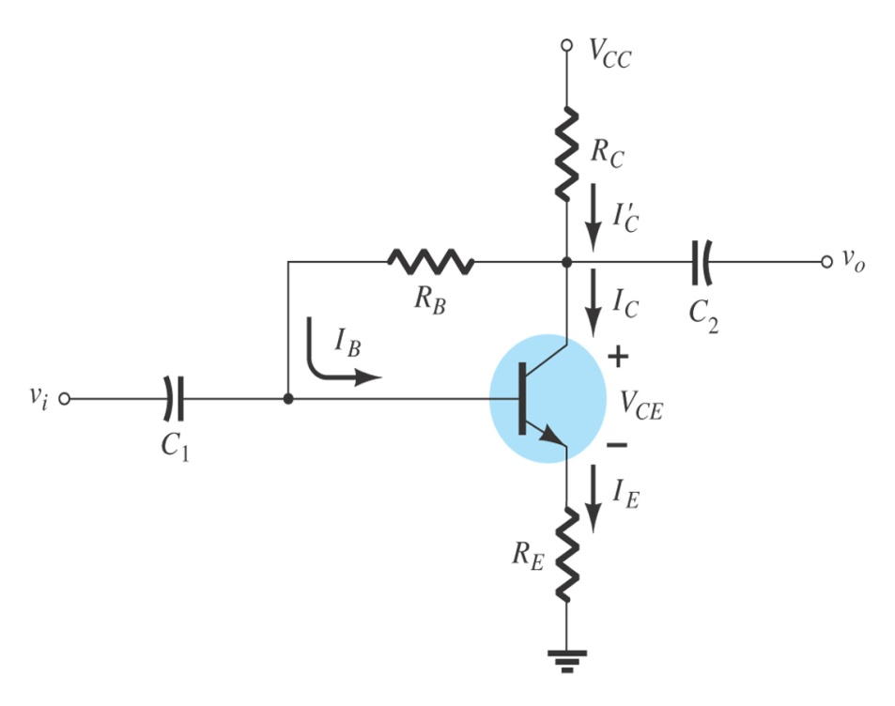
Collector Feedback Bias (DC Bias with Voltage Feedback)
An improved level of stability can also be obtained by introducing a feedback path from collector to base.
If I_{C} tries to increase, it drops more voltage across R_{C}, thereby causing V_{C} to decrease. When V_{C} decrease, there is a decrease voltage across R_{B}, which decrease I_{B}. The decrease in I_{B} produce less I_{C} which in turn, drops less voltage across R_{C} and thus offsets the decrease in V_{C.}
These feedbacks keep the Q-point stable.
I_{C} ↑ V_{RC} ↑ ➔ V_{C} ↓ V_{RB} ↓ ➔ I_{B} ↓
➔ I_{C} ↓ V_{RC} ↓ ➔ offset the decrease in V_{C}
V_{C}

Slide 28
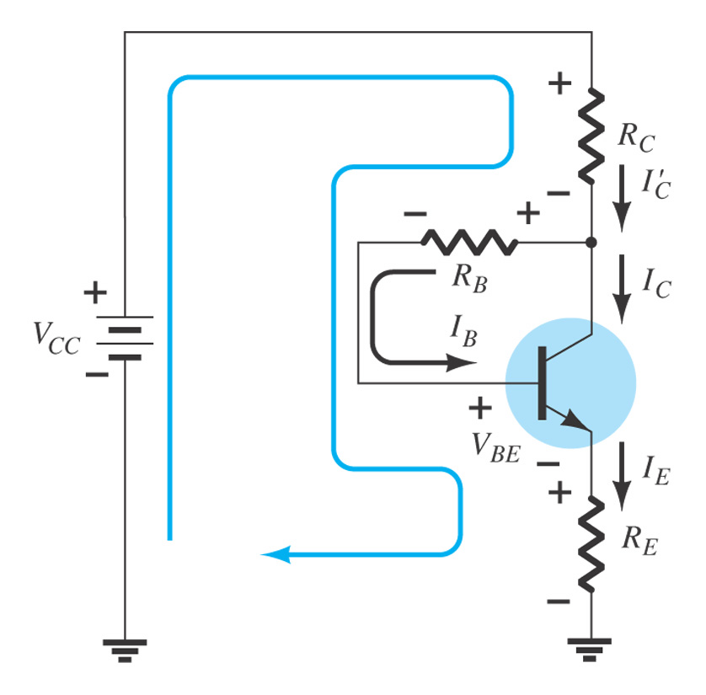
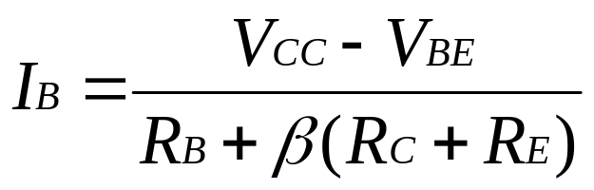
Collector Feedback Bias (DC Bias with Voltage Feedback)
Base – Emitter Loop
VCC – IC'RC – IBRB – VBE – IERE = 0
Actual case IC' = IC + IB
Approximation can be employed :
IC' ≅ IC = βIB and IE ≅ IC
VCC – VBE - βIB (RC + RE) – IBRB = 0
Solving for IB, yields

Slide 29
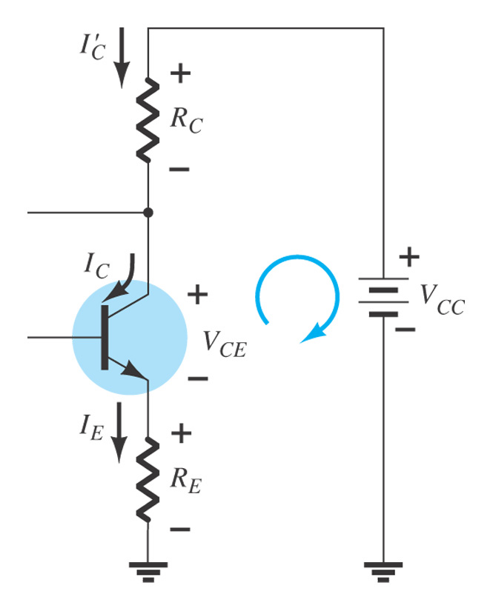
Collector Feedback Bias (DC Bias with Voltage Feedback)
Collector – Emitter Loop
VCC – IC'RC – VCE – IERE = 0
Approximation can be employed :
IC' ≅ IC and IE ≅ IC
VCC – VCE - IC (RC + RE) = 0
VCE = VCC – IC (RC + RE)

Slide 30

TROUBLESHOOTING
Shown is a typical voltage divider circuit with correct voltage readings. Knowing these voltages are required before logical troubleshooting can be applied. We will discuss some of the faults and symptoms.

Slide 31
TROUBLESHOOTING
R1 Open
With no bias the transistor is in cutoff.
Base voltage goes down to 0V.
Collector voltage goes up to 10 V (V_{CC}).
Emitter voltage goes down to 0V.

Slide 32
TROUBLESHOOTING
Resistor R_{E} Open:
Transistor is in cutoff.
Base reading voltage will stay approximately the same.
Collector voltage goes up to 10V(V_{CC}).
Emitter voltage will be approximately the base voltage + 0.7V.

Slide 33
TROUBLESHOOTING
Base Open Internally:
Transistor is in cutoff.
Base voltage stays approximately the same.
Collector voltage goes up to 10V(V_{CC}).
Emitter voltage goes down to 0V.

Slide 34
TROUBLESHOOTING
Open BE Junction:
Transistor is in cutoff.
Base voltage stays approximately the same.
Collector voltage goes up to 10V(V_{CC})
Emitter voltage goes down to 0V.

Slide 35
TROUBLESHOOTING
Open BC Junction:
Base voltage goes down to 1.11V because of more base current flow through emitter.
Collector voltage goes up to 10V (V_{CC}).
Emitter voltage will drop to 0.41V because of small current flow from forward biased base-emitter junction.

Slide 36
TROUBLESHOOTING
R_{C} Open:
Base voltage goes down to 1.11V because of more current flow through the emitter.
Collector voltage will drop to 0.41V because of current flow from forward biased collector-base junction.
Emitter voltage will drop to 0.41V because of small current flow from forward biased base-emitter junction.

Slide 37
TROUBLESHOOTING
R₂ Open:
Transistor pushed close to or into saturation.
Base voltage goes up slightly to 3.83V because of increased bias.
Emitter voltage goes up to 3.13V because of increased current.
Collector voltage goes down because of increased conduction of transistor.

Slide 38
SUMMARY
The purpose of biasing is to establish a stable operating point (Q-point).
The Q-point is the best point for operation of a transistor for a given collector current.
The dc load line helps to establish the Q-point for a given collector current.
The linear region of a transistor is the region of operation within saturation and cutoff.

Slide 39
SUMMARY
Voltage-divider bias is most widely used because it is stable and uses only one voltage supply
Base bias is very unstable because it is β dependant.
Emitter bias is stable but require two voltage supplies.
Collector-back is relatively stable when compared to base bias, but not as stable as voltage-divider bias.

Slide 40
THANK YOU

